Slide 1
CS116 final project
Dustin Van Tate Testa

Slide 2
Solution Overview
Everything which exists in the simulation as it's own entity is assigned a unique id property
The actual objects are stored in the RoadNetwork Class in arrays, and are only referenced to by their id's
Everything which operates during the simulation has a tick() method which gets called once per tick
The locations of the components in the simulation are not stored, but instead the relationships between the Blocks are stored in an neighbors[] array of the neighboring Block id's.

Slide 3
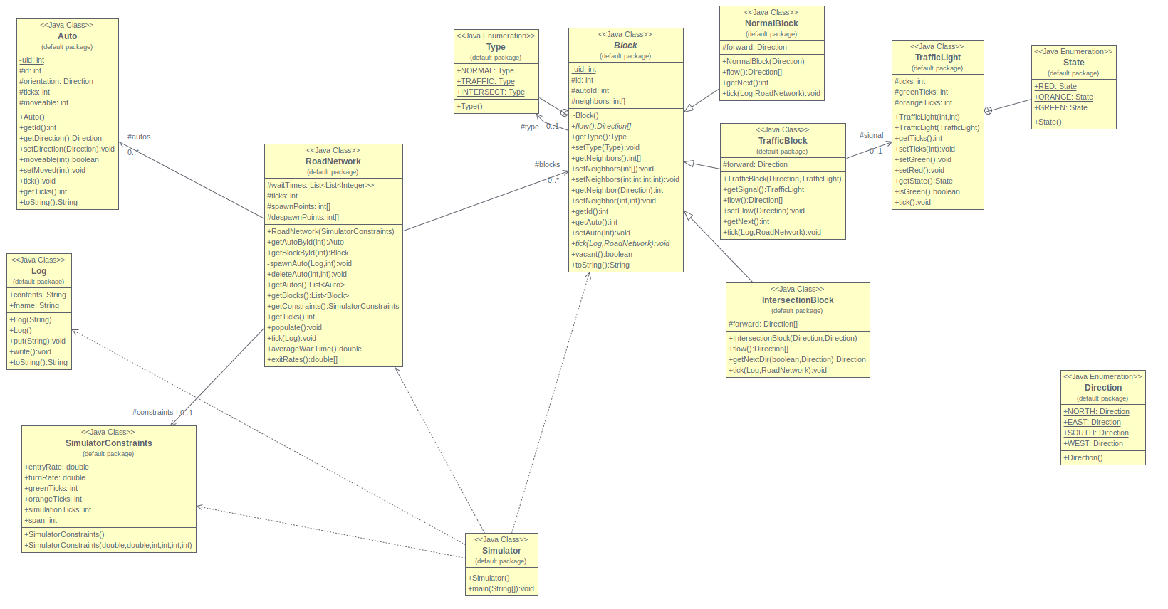
uml of everything

Slide 4
Note on directions
directions are from compass rose, at times I converted them to fit conventions used in project guide, but i felt that they were confusing so I used things like Direction.NORTH instead of Direction.SN
directional ordinals are in clockwise order, starting from north. (NESW)

Slide 5
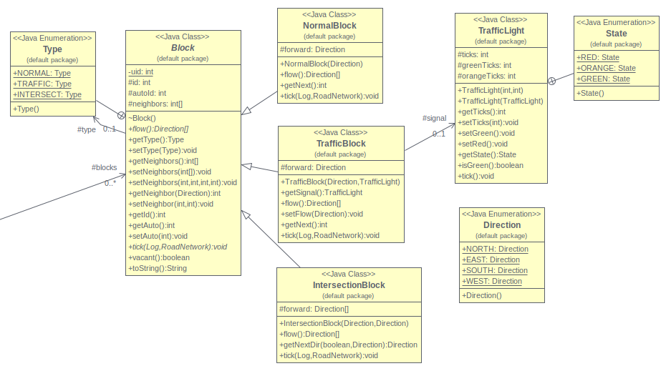
Blocks UML Overview

Slide 6
3 types of blocks
NormalBlock: where cars enter and leave simulation
quantity: 4*span + 4*(span - 1)
TrafficBlock: traffic light, entrance to intersection system
quantity: 4
IntersectionBlock: where cars can decide to change directions
quantity: 4

Slide 7
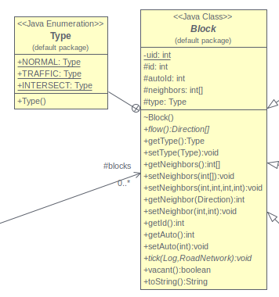
Keypoints of Block abstract superclass
Nested enum for the type of the block is used for debugging
because intersect blocks need to have multiple directions, this is left out of the superclass and instead an array is returne by flow(), which could have multiple lengths.
key attributes:
id: unique id
autoId: id of the car on the block (zero if there isn't a car)
neighbors[]: id's of the neighboring blocks
key methods:
abstract tick() which handles the movement of the auto
vacant() to tell if car is in the current block
relevant accessmodifiers and mutators
toString() gives block type and id

Slide 8
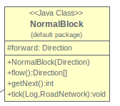
Keypoints Of NormalBlock subclass
attribute forward is the Direction of forward for the block
tick() method:
no auto? do nothing
if the next block isn't vacant, move the auto to it
if there is no next block, make the car exit the simulation via methods from RoadNetwork

Slide 9
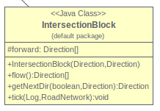
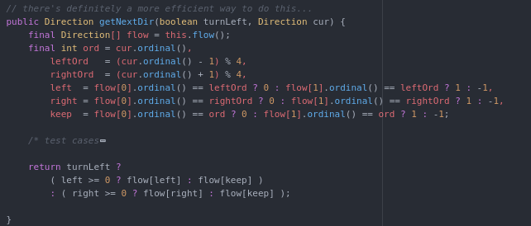

Keypoints of the IntersectionBlock subclass
Direction[] forward holds the two directions the vehicle can go from the intersection block
because the guidelines say left/right turning instead of ordinal directions, i had to make a function which finds the turn direction based on the cars current direction and the directions the intersection supports by converting left and right to clockwise and counterclockwise on the compass.
the tick method passes a random turn value (where user provided turningRate is likeliness car will turn left).
Note, somtimes left/right == straight

Slide 10
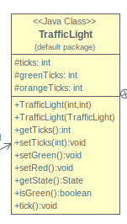

TrafficLight class
enum typedef for the state of the light
attributes for current tick, number of ticks for green and orange.
unimportant note: as a C++ programmer, without even thinking i did the appropriate steps to make this class work with unsigned 8 bit integers instead of java's ints so it should be even more failsafe.
entire system uses clocklike adding

Slide 11
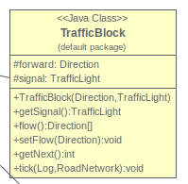
keypoints of the TrafficBlock subclass
has a trafficlight member
tick() method updates traffic light, and if its green moves auto along, otherwise, writes to the log that the auto is waiting at the stoplight.

Slide 12
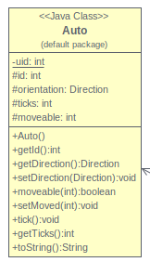
keypoints of the Auto class
only funcitonality contribution is to count the number of ticks needed to complete its path as its movement is handled by the road.
each tick it adjusts its internal clock
if the car is moved it calls the setMoved(current tick) method so that it only moves once per tick
kinda a bodge after i noticed that cars did their entire path in only 5 ticks or so (awk)
the orientation of the car is loosely tracked and set when it goes through different blocks so that the intersection blocks know from what direction it came from
cars have unique ids too

Slide 13
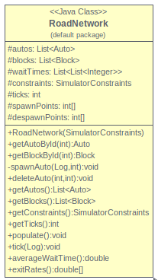
Keypoints of the RoadNetwork class
This service class is where the majority of the actual functionality of the project stems from.
Attributes:
autos, blocks: list of all autos and blocks in current simulation
waitTimes: commute times for cars exiting simulation (organized by exit)
ticks: current tick number
spawnPoints[], despawnPoints[], id's of blocks where Autos are added/removed from the system

Slide 14
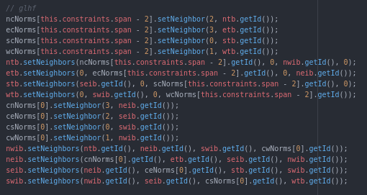
RoadNetwork methods
constructor: sets user-provided constants and instantiates ArrayLists
getAutoById(), getBlockById(): returns reference to Block/Auto corresponding to given id
spawnAuto(): adds an auto to simulation at given spawn point
deleteAuto():
removes auto from simulation
adds it's commute time to waitTimes
access modifiers: because i wanted to use protected members
populate(): 150+ line function i wrote over the course of 3 different time periods yet surprisingly worked essentially perfectly without having to change anything
instantiates every block element, links them together correctly, fills in the correct id's to the other attributes, and puts the blocks in the blocks attribute
tick():
updates Autos
updates Blocks (which move Autos)
spawns cars according to the entry rate
averageWaitTime(): average wait time for autos which passed through simulation
exitRates(): number of vehicles exiting each exit per tick

Slide 15
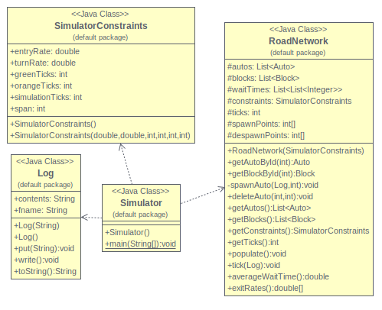
Client uml overview

Slide 16
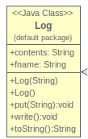
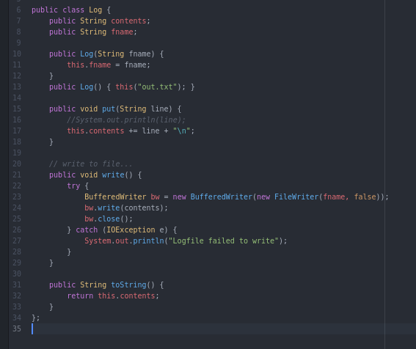
Log class
this handles the compilation of messages into the output file
constructed with a filename,
use .put() to add log entries
use .write to output to the file

Slide 17
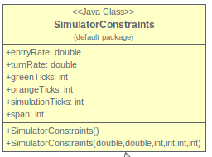
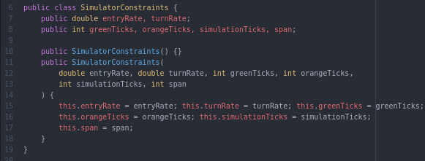
SimulatorConstraints
i made this type to simply combine all the information the user has to enter into one thing i can pass to the RoadNetwork class. I would normally use a struct to do this in C++ or an anonymous object in javascript so i didn't feel bad about making everything public.

Slide 18
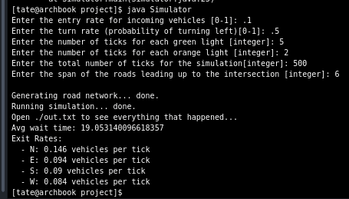
Simulator
This is just a client so everything is in the main method
Instantiates SimulatorConstraints object and prompts user to fill in its values.
Makes a Log object
makes and populates road network
runs simulation by calling .tick() number of times specified
formats and prints output of .averageWaitTime() and .exitRates()

Slide 19
Test cases
the following slides are the methods that I verified that everything works.
There may be a few others which i have neglected to include or more which were more trial with error and analysis

Slide 20
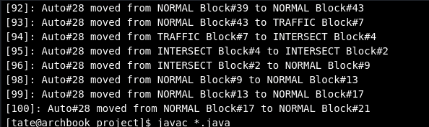
Autos move:
I added print statements to every block to show where the auto was moved from and to.
the below screenshot shows that the autos move between blocks

Slide 21
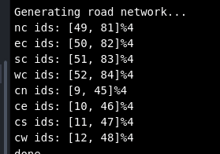
Debugging info for individual blocks
To make sense of the debugging information mentioned previously, i need the ids of every block
the first blocks are defined in a specific order and i can find this, the rest are defined as offsets of an initial value, and thus i had to print these out when debugging

Slide 22
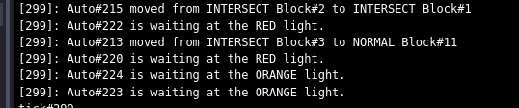
traffic lights are working
I added some code to print every time an auto is waiting at a stoplight to make sure they're properly cycling

Slide 23
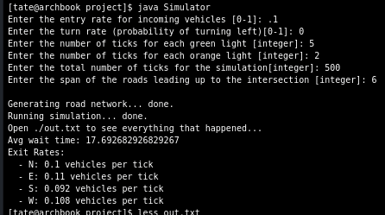
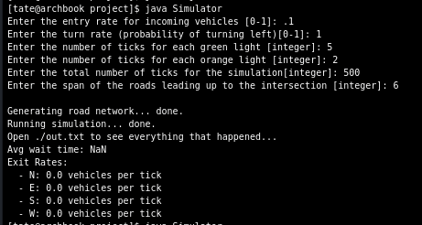
turning and navigation works correctly
I tested this multiple ways:
by changing the turning constant (probability of turning left) to one and zero, to verify results are as expected
see screenshot
by printing out the turn values
works as expected
- when vehicles always turn left it eventually stops traffic
- when vehicles always turn right it produces perfectly even results

